Slide 1
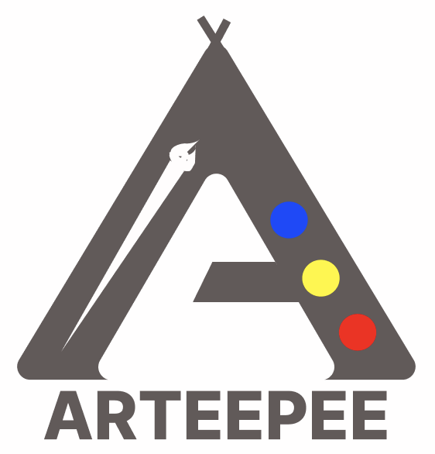
ARTEEPEE
July 2022

Slide 2
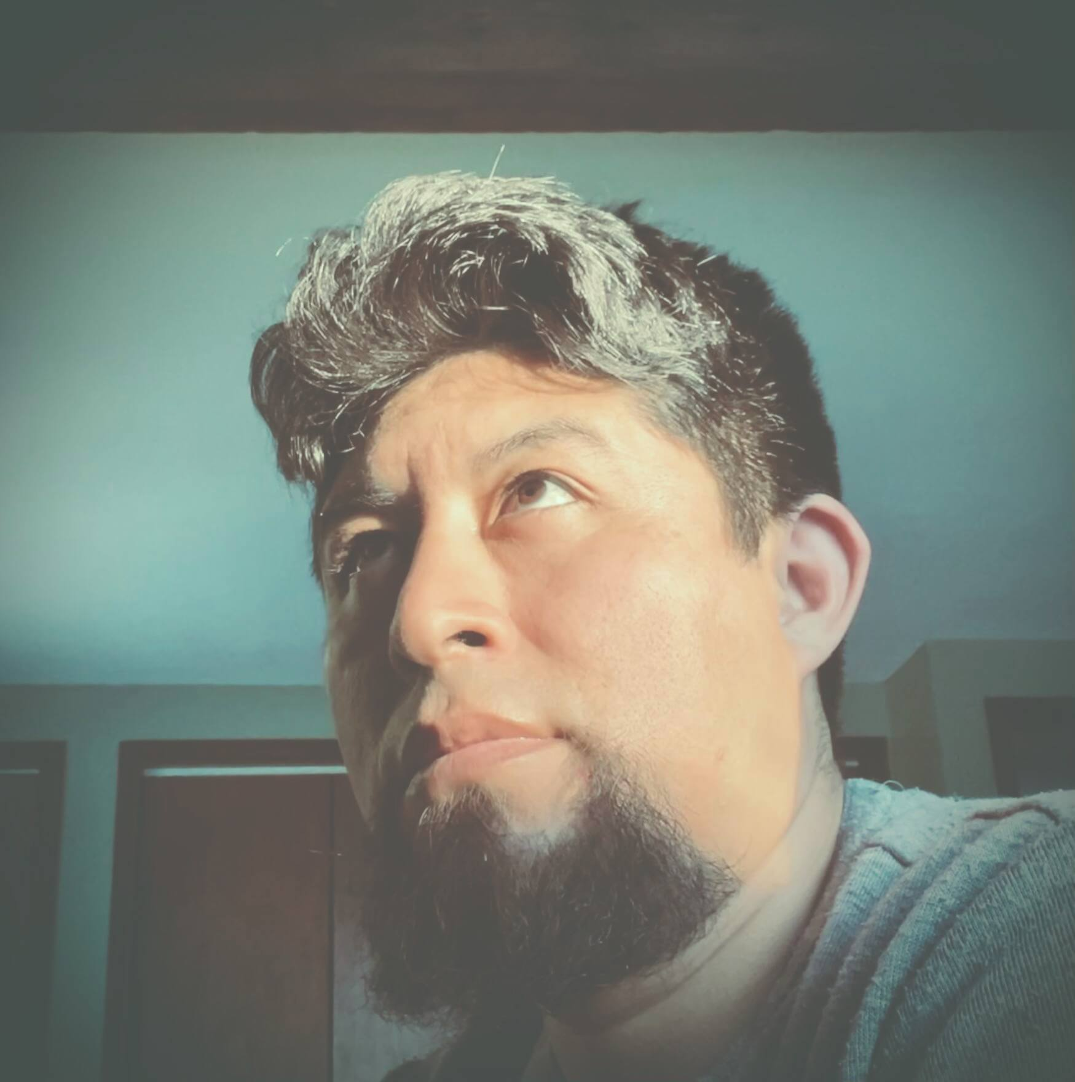
Team
Name: Elver Yarin
Role: Front-end Engineer
Notes:
• An introduction of team members and their roles

Slide 3
The Problem
study art is mad expensive and not a lot of people can afford it and a website that anyone can access for free is the goal of this project.
Arteepee is an advisor website dedicated to providing support to those who want to learn how to paint watercolors, or are looking for answers on the artistic field.
Notes:
• An explanation of the reason for the project and the need it serves

Slide 4
Goals
The main goal is provide help and support to those who are beginners or enthusiast in the arts.
To mentor with techniques, advises, and sharing materials that may help you get started, by giving visual guidance in the artistic field .

Slide 5
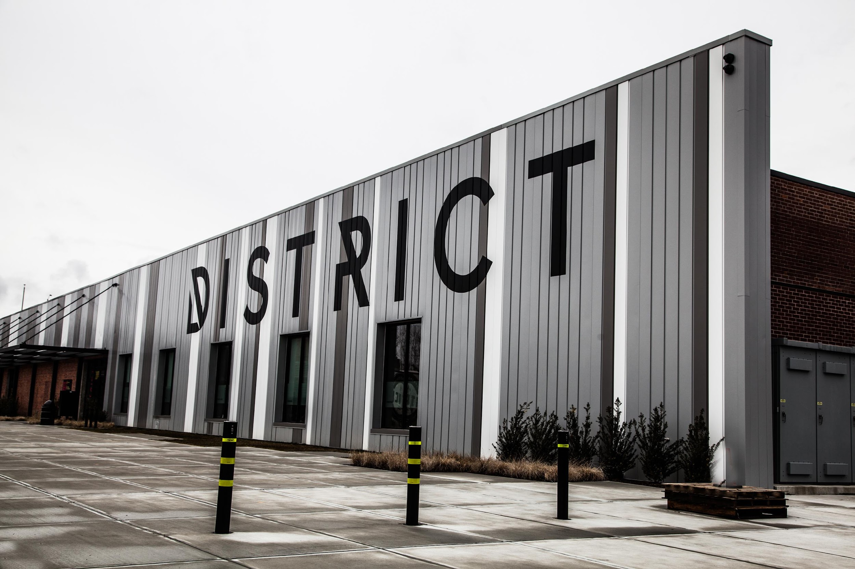
The Solution
share visual material of the watercolor painting process.
Giving tips and knowledge of materials tools and techniques.

Slide 6
Design process
. First I made a sketch of the structure and layout of elements.
.Next I’ve made a list of menu titles on navigation bar.
.List of topics focus in watercolor.
.Gather images and videos relevant to the area.
.I started building the menu bar, follow y the pages.
.Styles the elements.
.lastly add a footer.
Notes:
• A summary of the design process including research, design decisions, successes and lessons learned

Slide 7
Project Plan and Timeline
Build this project took about two weeks to , originally I invest more time trying to understand python which I never experience programing with, anyway in order to accomplish this web site it was necessary to plan it ahead I divided the process by pages.
One day I’ve start with the menu bar along with the home page plus editing images I had to use , and the next day I’ll work in the following page and I’ll style it as we go, and lastly I’ve work on the footer.
Notes:
• An outline of the project plan, justification for any deviations and communicate lessons learned

Slide 8
Technology Stack
To be able to program and build a website is a 100% necessary the use of tools, and for this project I had used the following:
. Figma
. Github
. V.S. Code
. Youtube
. Codepen
Notes:
• An explanation of the chosen technology stack

Slide 9
Demo
file:///Users/elveryarin/Desktop/myModulo8/index.html

Slide 10
Future Development
. I would add demos of my own, and share the way I work.
. Maybe add a link that would allow me to give personal guidance and interact with those who want to learn how to paint.
. We all did very good projects just using basic knowledge but I’ll love to learn more and improve what i can do.
Notes:
• A summary of the design process including research, design decisions, successes and lessons learned

